Slide 1
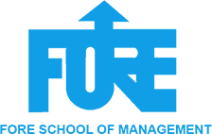
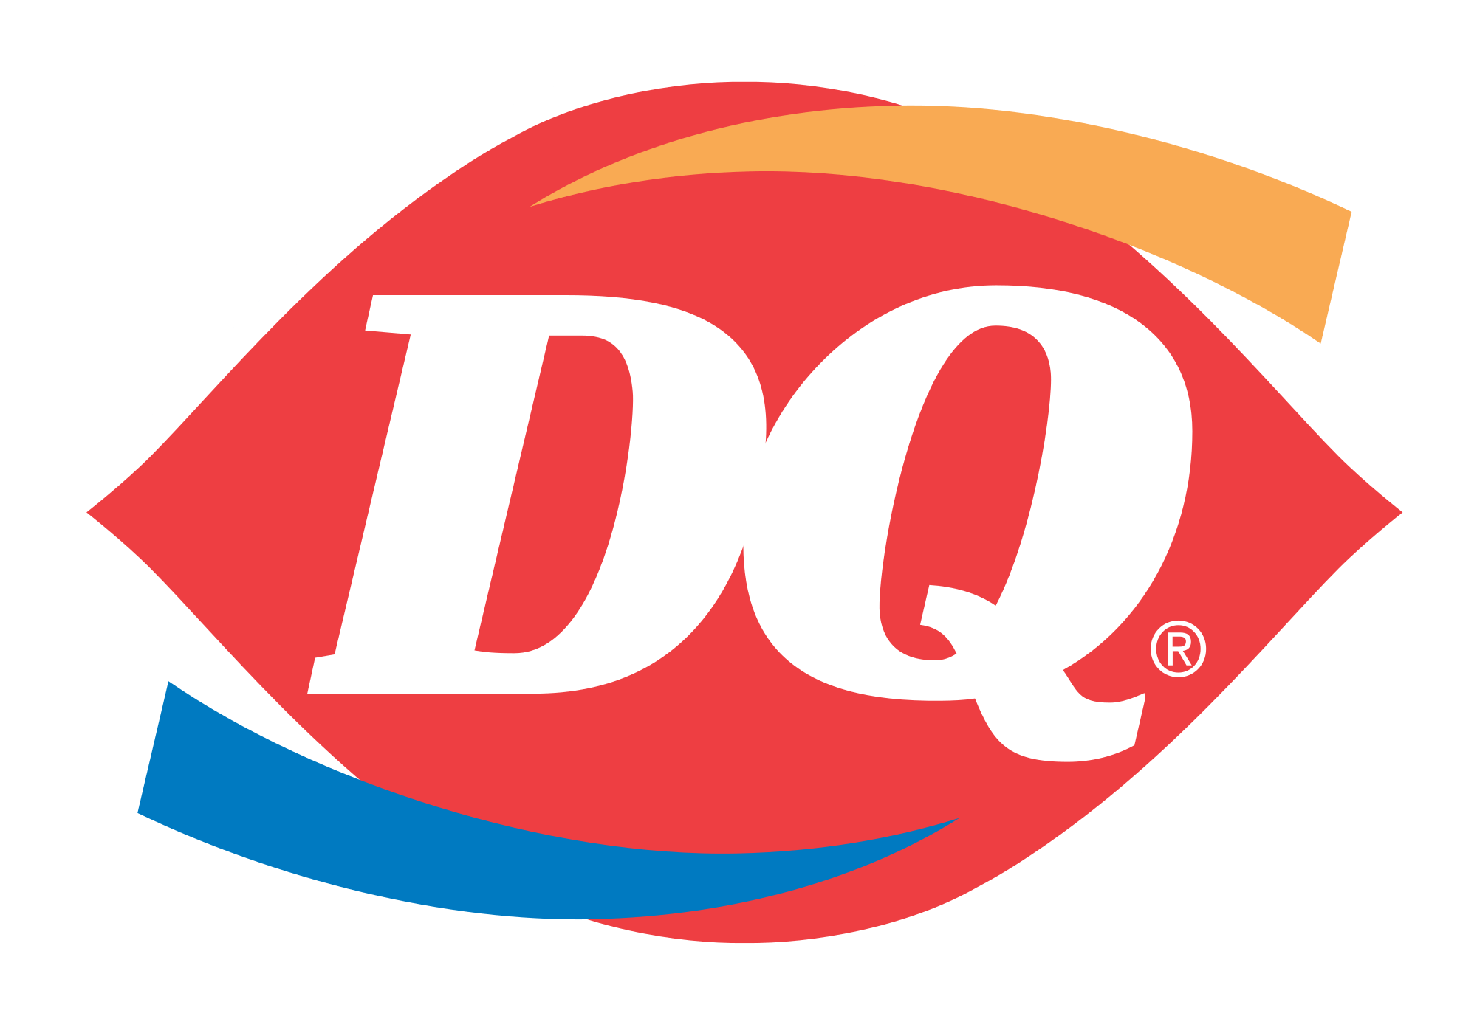
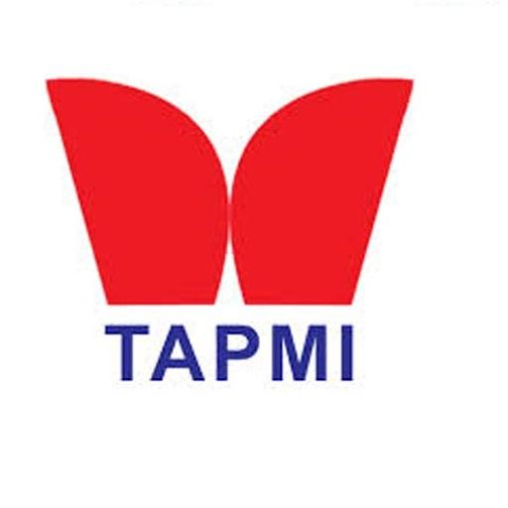

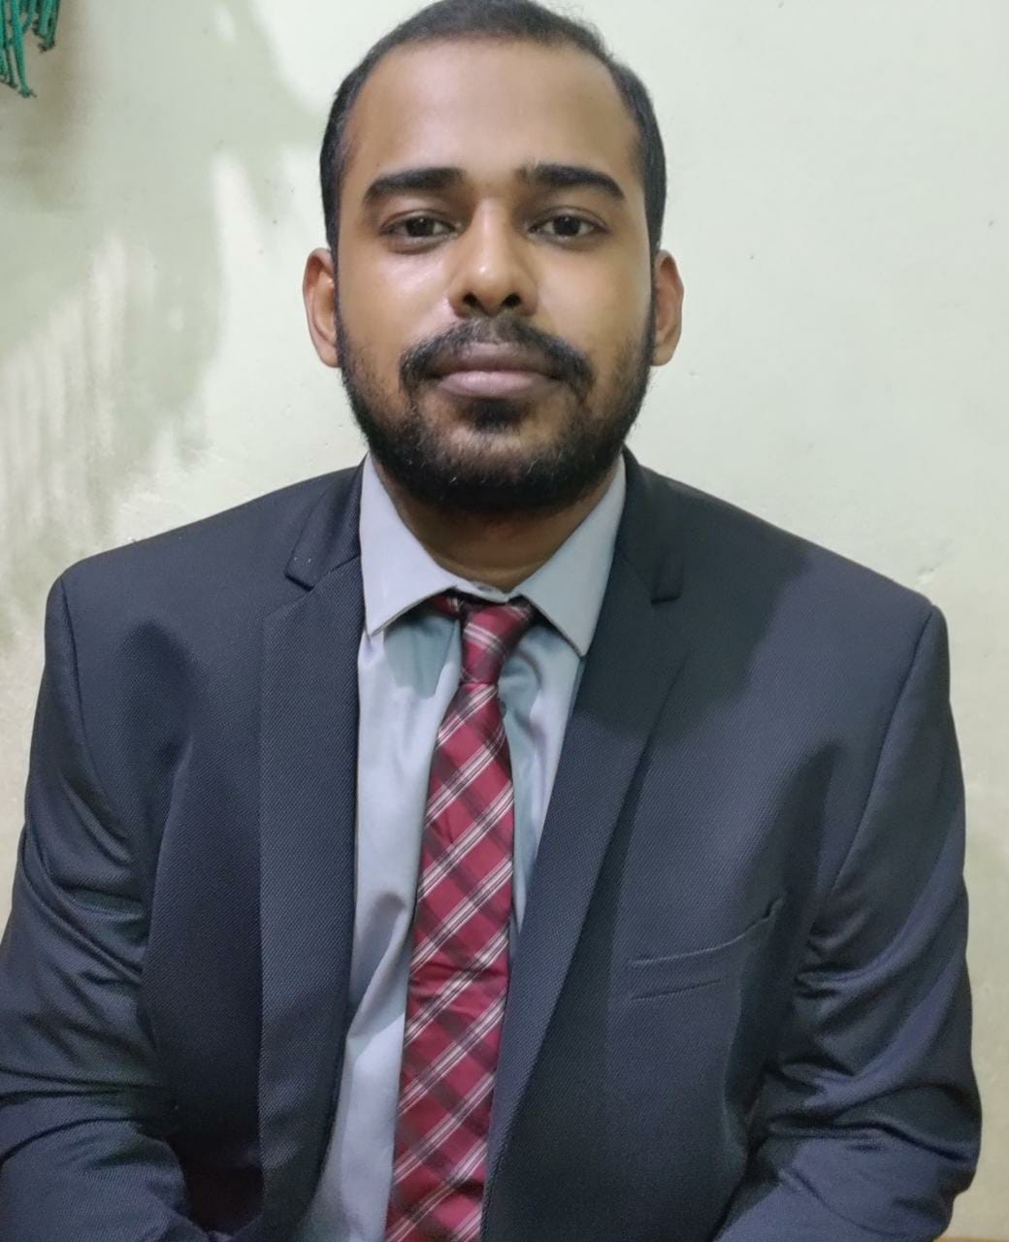

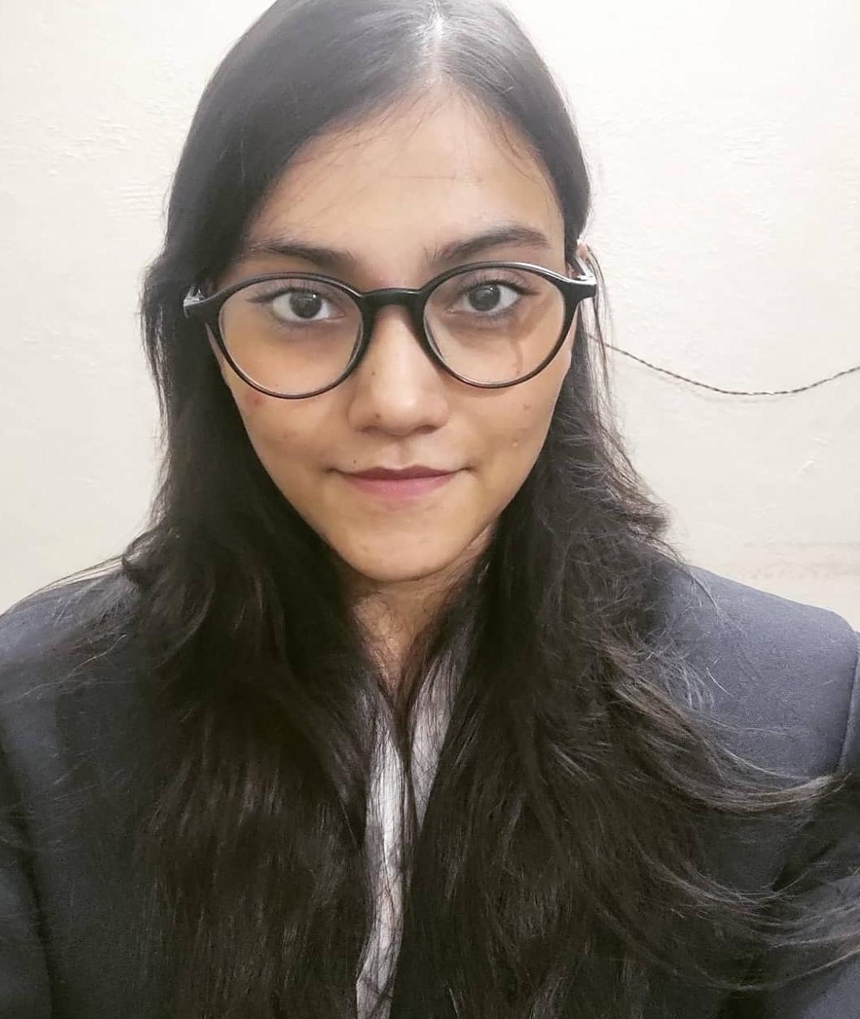
Team SORTED
Devesh Sinha Mohit Kiradoo Kajal Gupta
T. A. Pai Management Institute

Slide 2
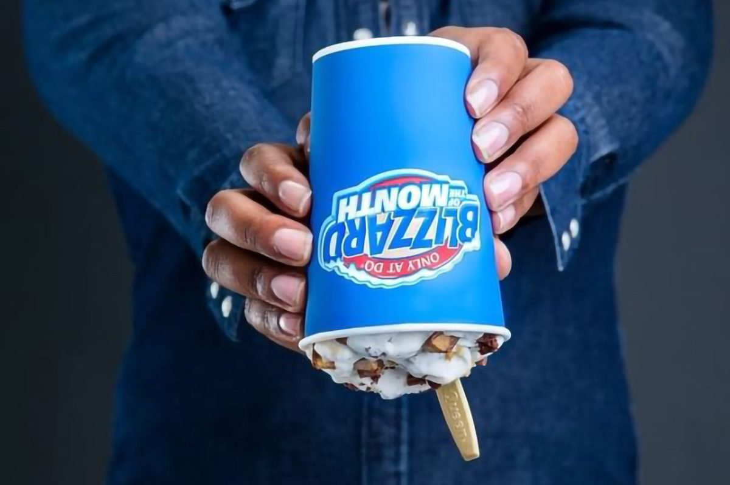
About the Brand
QSR Market in India
SWOT and TWOS matrix
Marketing Strategy
Strategic Steps
About the brand
USP
DQ is one of the oldest American QSR chains established in 1940 with its vision to be the most favorite QSR chain of the world.
The largest Dairy Queen in the US is in Bloomington, Illinois. The largest in the world is in Riyadh, Saudi Arabia, and the busiest in the world is in Charlottetown, Prince Edward Island.
The liquid capital required to invest in a Dairy Queen franchise is $400,000, and the minimum net worth is $750,000.. The initial franchise fee is $45,000, while the total investment amount required ranges from $1.1 million to $1.8 million.
DQ is now known for its iconic Blizzard, where candy and other delicious toppings like cookies and brownies are mixed into ice cream for a decadent sweet treat and they are served upside down
Product: Limited Menu. Famous products are – Blizards, Dipped Cones, Moolattes, Waffle bowls, Arctic Rush, Shakes and Burgers
Place: Present in more than 7,000 locations in the United States, Canada and more than 20 other countries
Price: Dairy queen pricing strategy is a seasonal discount. Price reduction is during a given time of the year They use promotional pricing: this makes use of technical price reductions discounts, pay later, special offers, and vouchers.
Promotion: Focus more on social media marketing. More than 2m followers on social media. Also do ATL advertisements during store launch or new product launch such as TV Ads, Billboards and Newspaper Ads

Slide 3

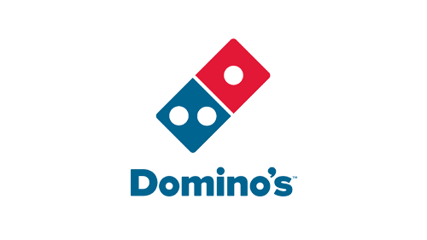
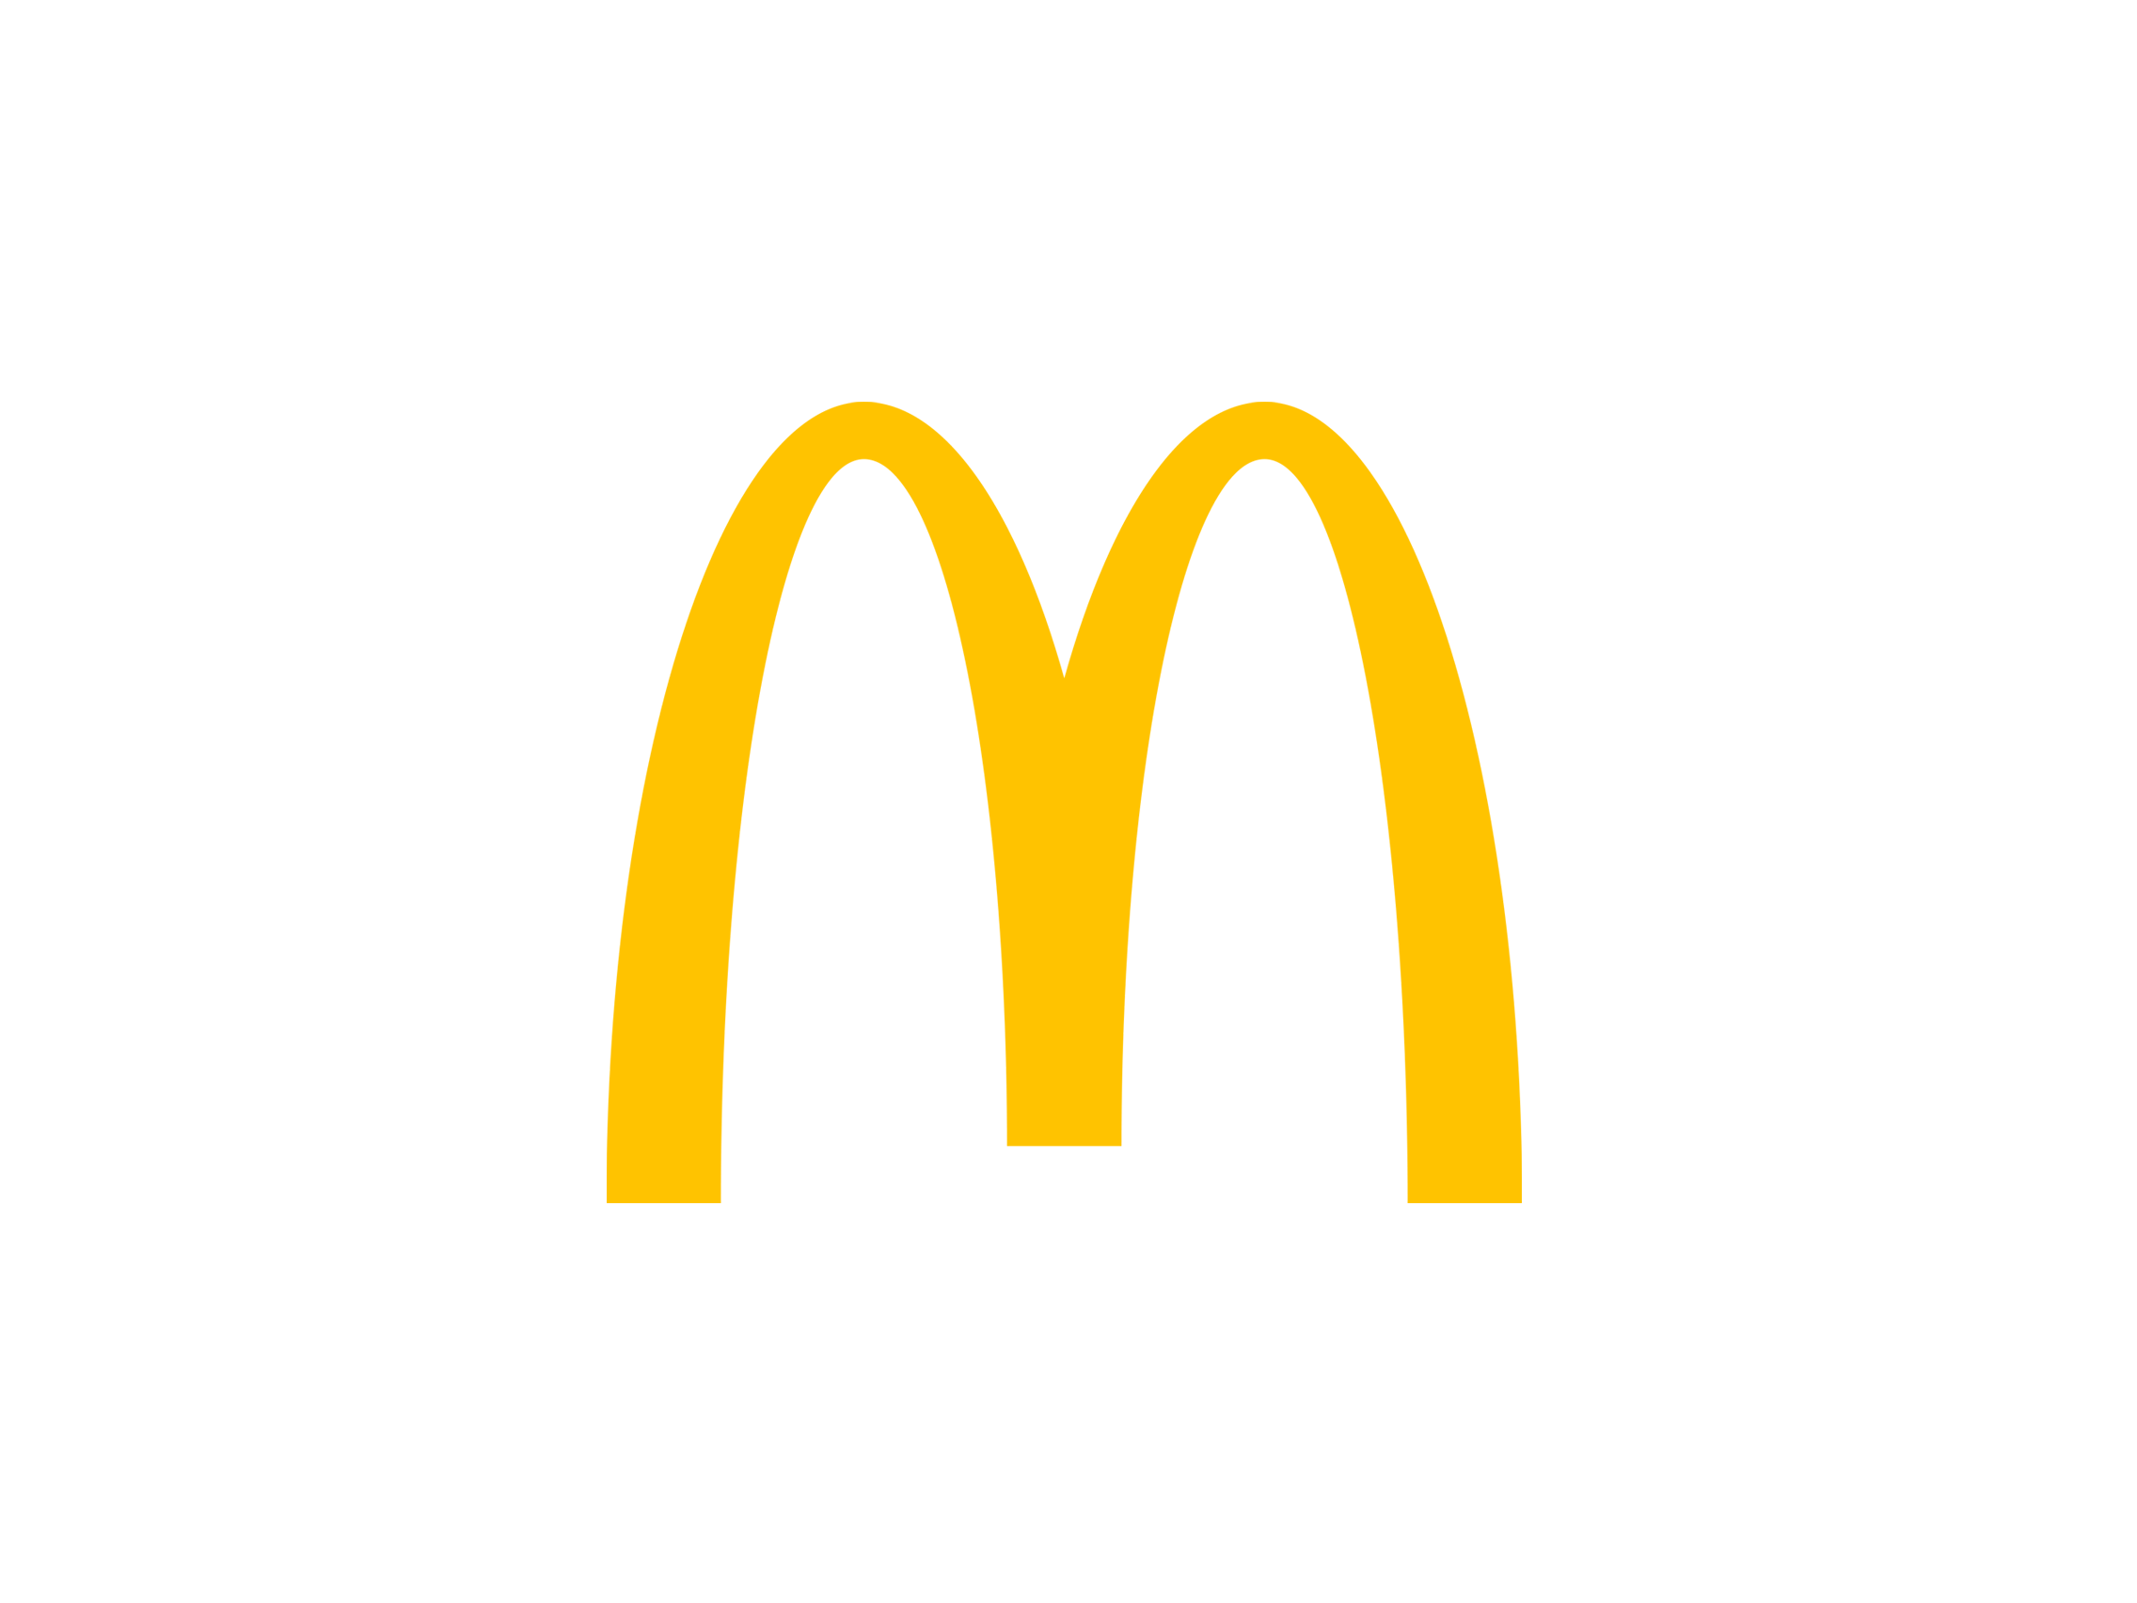
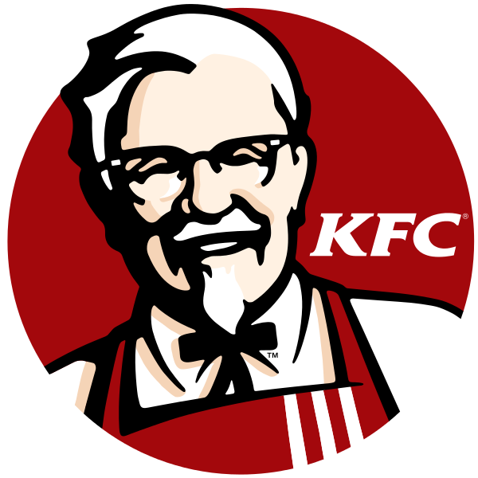
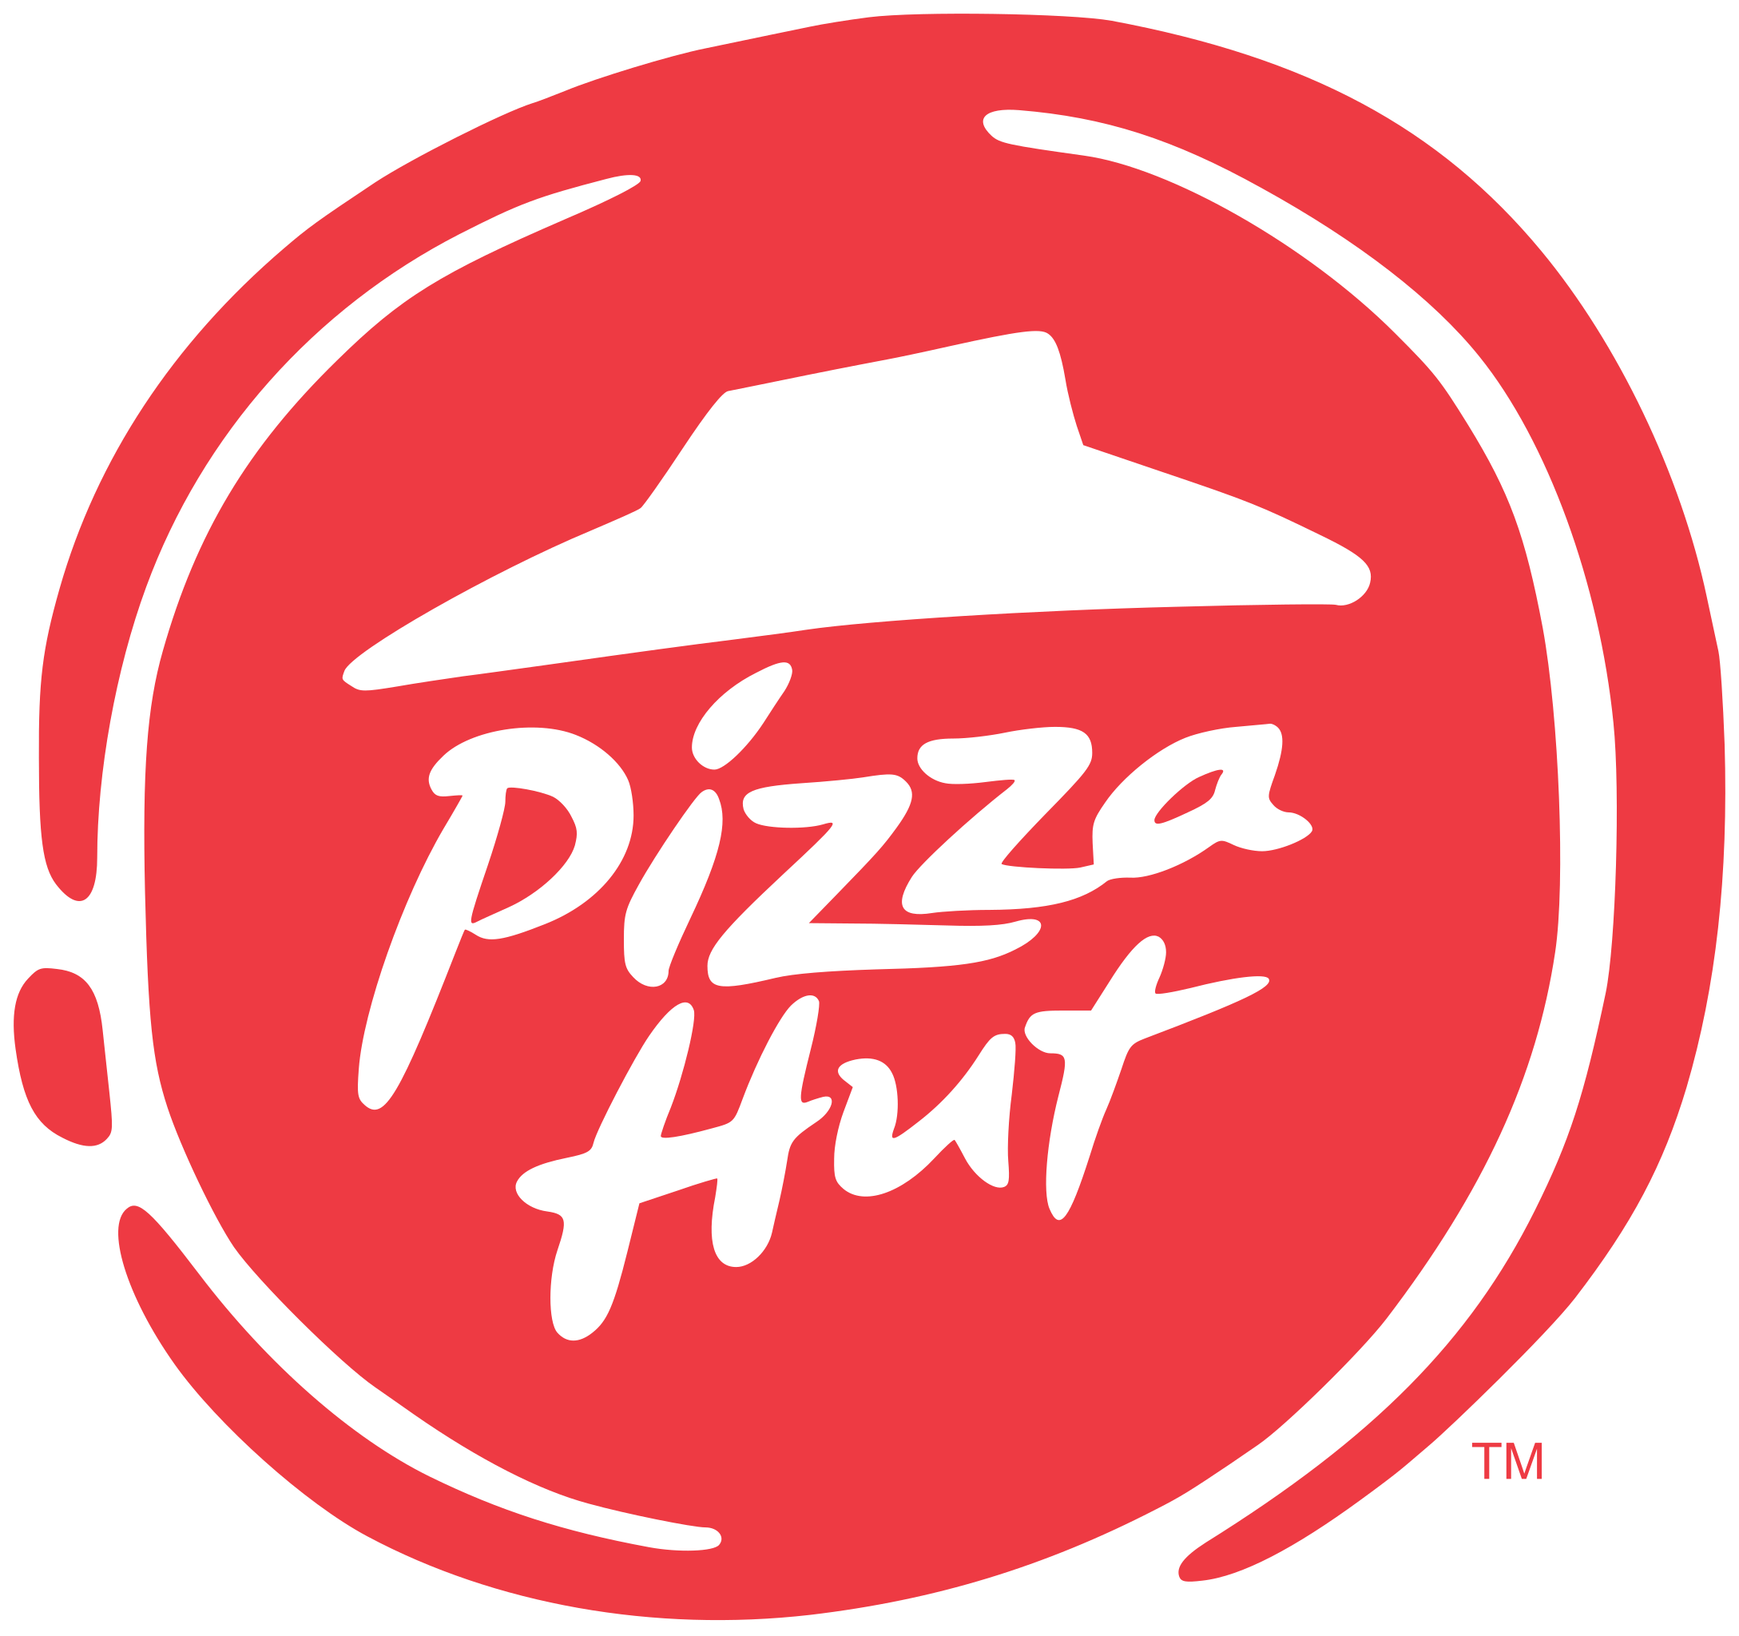
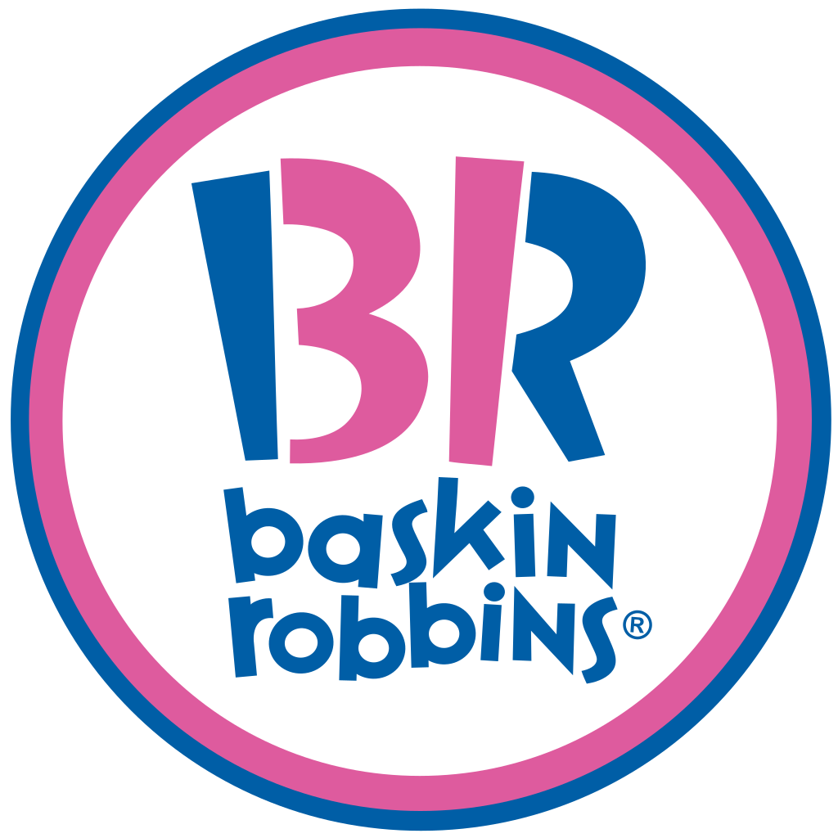
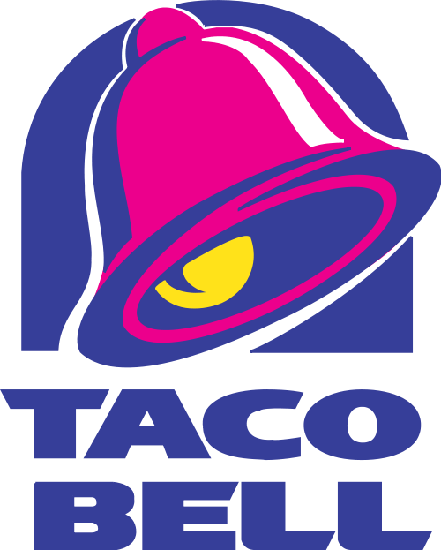
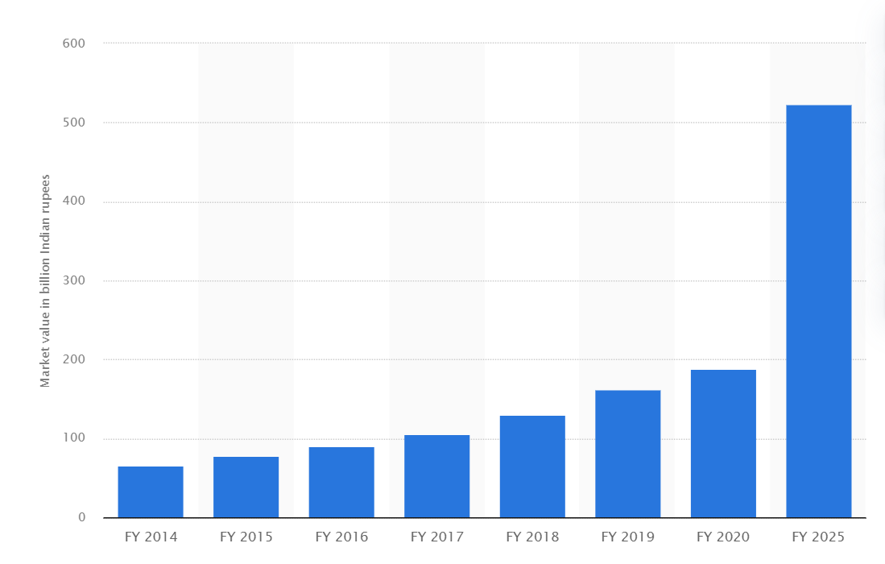
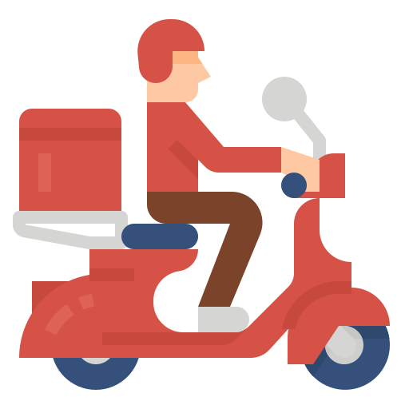
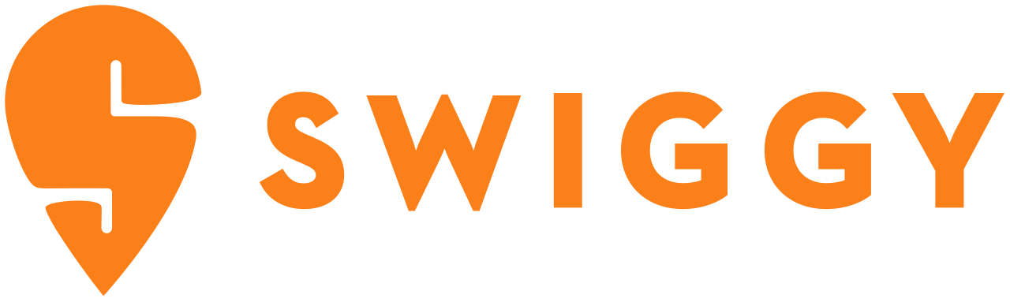
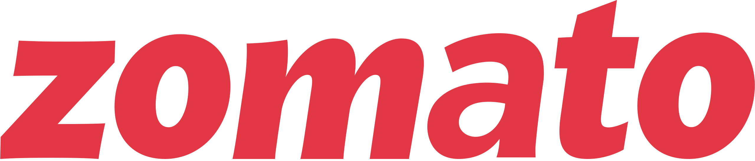
About the Brand
QSR Market in India
SWOT and TWOS matrix
Marketing Strategy
Strategic Steps
188
Billion rupees is the market value of QSR chains in India in 2020
Unorganized versus organized QSR sector
Roadside eateries, Dhabas, and food stalls, the traditional fast-food formats form a major part of the unorganized sector. The organized fast-food sector in India is dominated by global food chains like Dominos, McDonalds, KFC and Pizza Hut. These leading chain restaurants successfully catered to the country's population and by adding customized dishes to their standard menus.
500
Billion rupees is the expected market value by 2025
Market drivers: Rising exposure to western food and culture along with the higher disposable income of the middle class
Impact of COVID-19 on QSRs
The food service industry was tremendously affected by the COVID-19 pandemic and the subsequent lockdowns. The pandemic created a massive demand for online food delivery services. Swiggy and Zomato emerged as the leading food delivery services in the country and introduced new features such as grocery delivery, pay later services and running errands to stay ahead of their competitors.
Source: Statista

Slide 4

About the Brand
QSR Market in India
SWOT and TWOS matrix
Marketing Strategy
Strategic Steps
Strengths:
Product differentiation and patented formulation, trademarks
Exclusive offerings where Blizzard is the hero product
Backing of strong brand Berkshire Hathaway
Automated customization offerings
Weaknesses:
Despite of 82 years of presence the company failed to expand its global footprints unlike new rivals like McD and Burger King
Less market share of food as it is still mainly perceived as dessert brand
SO (Maxi-Max strategies)
DQ should try the Blue Ocean strategy by creating its own category with its exclusive menu and tap the market opportunities
Blizzard to be the hero product in India as its unique here
ST (Maxi-Min strategies)
DQ should use the resources of Berkshire in India to conduct intensive market research to understand the Indian taste including FGD, DIs etc
DQ should use the market experience to carefully tackle the low price competitors
Opportunities in India:
Growth in the fast food market due to the emergence of food delivery start-ups after COVID
Need for a fresh brand with unique differentiation and product offerings in the semi premium range for Tier 2 and 3 cities
Increase in disposable income
Threats in India:
Huge dominance of McDonald’s, Burger King and the unorganized market as a low cost competitor
It is difficult to crack the Indian tastebuds with western offerings. Menu without changes has high risk of failing
WO (Mini-Max strategies)
In India DQ can expand quickly using right positioning and pricing through food delivery start-ups
Market Research on Indian tastebuds and redefined menu to project itself as a Fast-food chain and not a dessert brand
WT (Mini-Min strategies)
Avoid being driven away by the deep discounting and price wars by the low price competitors
Avoid any malpractices and quality compromises to establish itself in the market
Considering the existing rivalry in the organized sector and the huge dominion of the unorganized sector one could sense that it might be too late DQ to enter India. But the reality is Indian market has always been dynamic and welcomed new taste (rise of Momo culture), differentiated offerings (Starbucks and Taco Bell), Localized palette (Maharaja Mac) and Hero products (Burger King Whooper)

Slide 5
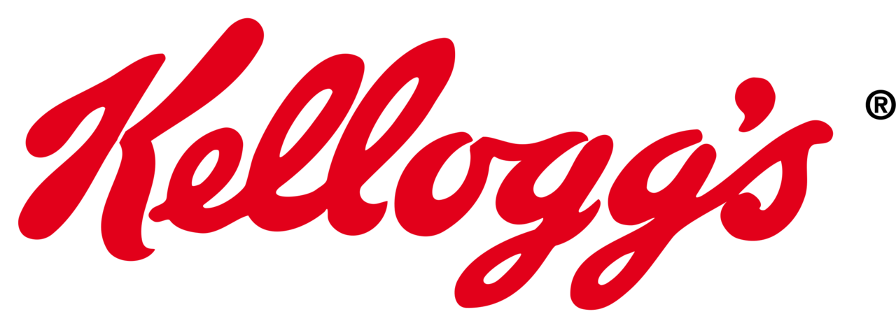
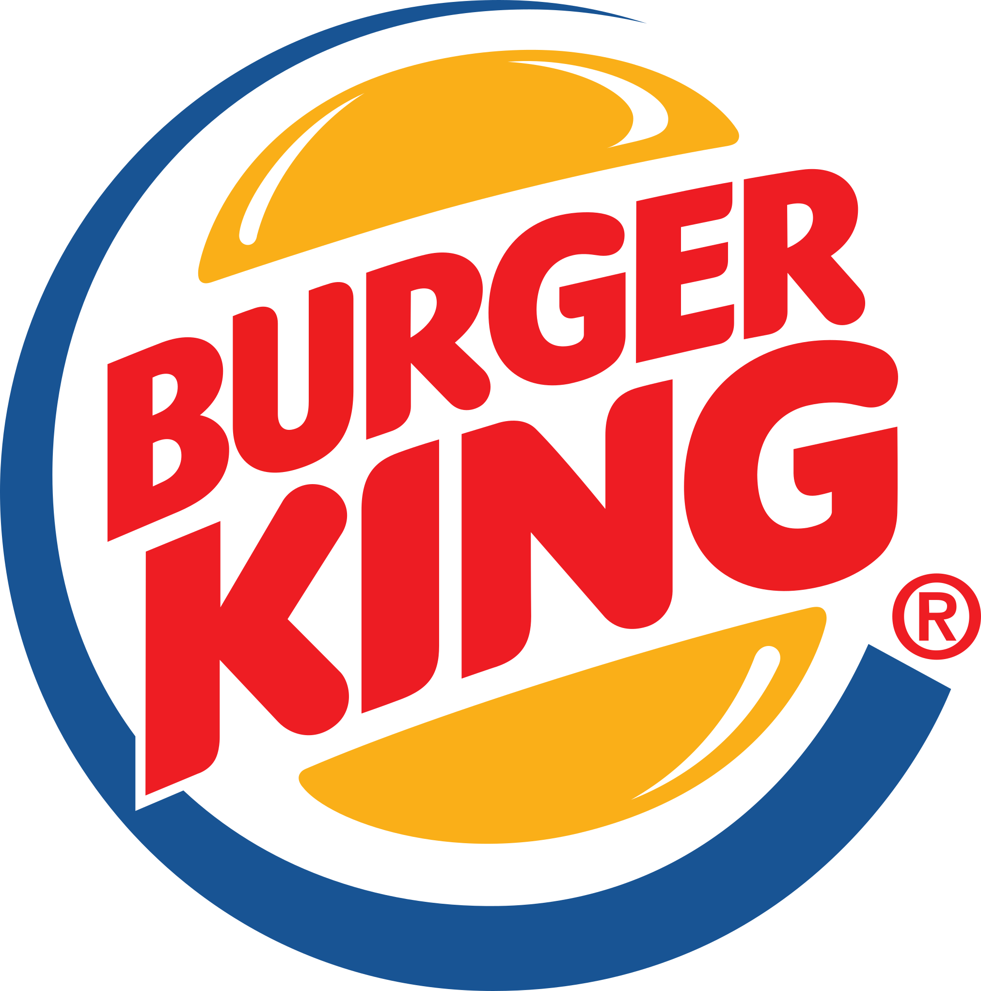
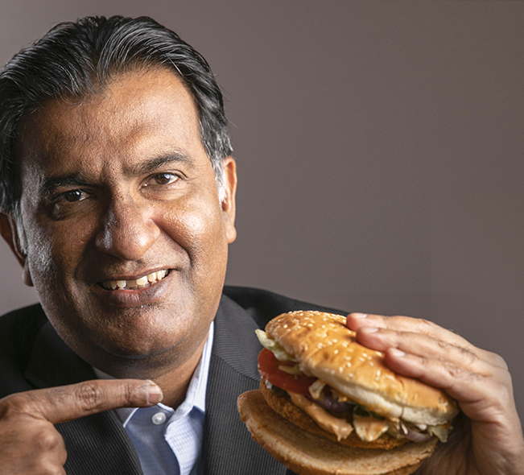
About the Brand
QSR Market in India
SWOT and TWOS matrix
Marketing Strategy
Strategic Steps
1
Localization of taste
3
Quality over quantity
Need: Menu that suits the Indian tastebud, eating habits and culture
Case study:
Kellogg’s wanted to change the Indian breakfast habit but failed
McDonald's thought their Beef burger will work in India too but failed due to cultural values
Need: DQ’s offerings are different from McDonald’s and Burger King. It has Blizzard and Beverages as the hero products and burgers and hot dogs are complimentary. Hence, they should avoid aggressive expansion with multiple franchise, but first open company owned outlets, test the market, set the product market fit and then expand
Case study:
Burger King did not participate in the price war with McD, rather they had a single master franchise like Jubilant and focused on company owned store to have control over the quality and process
2
Hiring Indian folks in the core team
Need: Local people in the core team know the tedious process in India
Case study:
Burger King India CEO – Rajeev Varman and his core Indian team of CFO, COO and CHRO is one the major reasons how Burger King covered half of McDonald’s market in just 3 years
4
Strategic sourcing
Need: Dairy Queen’s Blizzard is something that is new in India hence sourcing would be a major challenge for them to maintain the USP of Blizzard and add flavours according to seasons which they do in US. Hence, setting up their own manufacturing unit is recommended in a connected city of India. Ex – Nagpur, Pune etc
Source: https://www.forbesindia.com/article/take-one-big-story-of-the-day/burger-king-and-the-crown/66891/1#:~:text=It%20was%20the%20fag%20end,in%20South%20Delhi%20in%20November

Slide 6
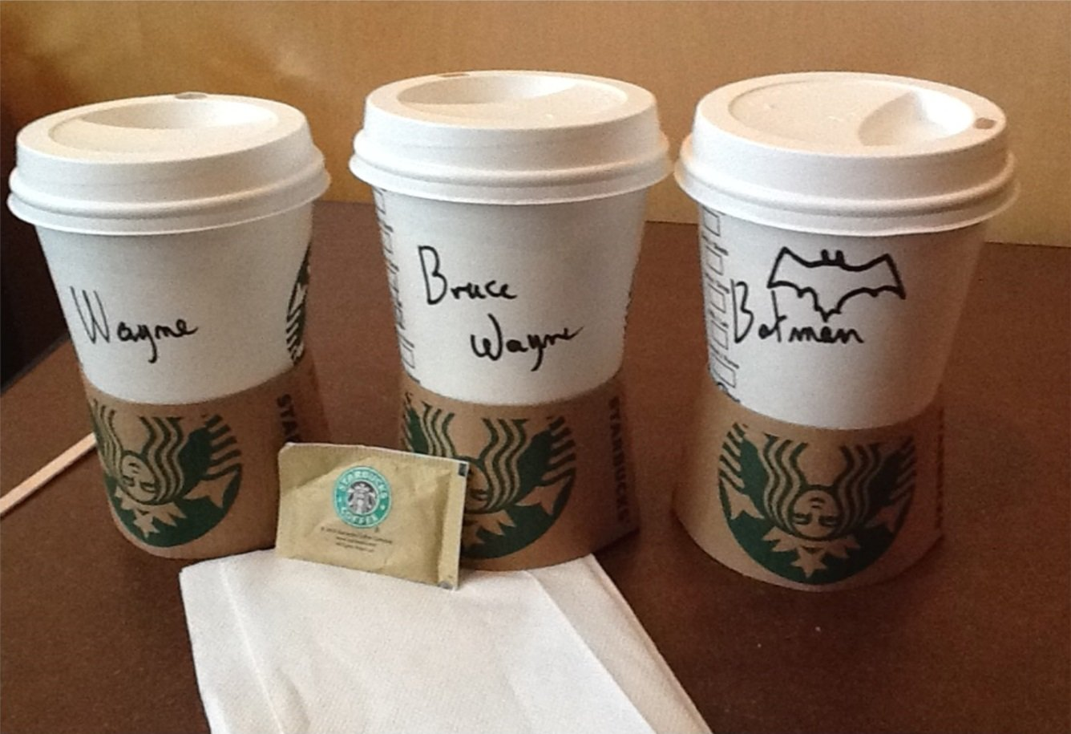
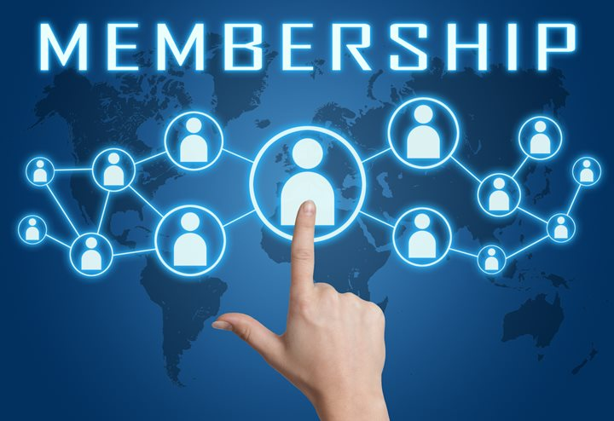
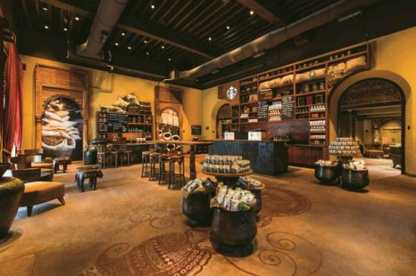


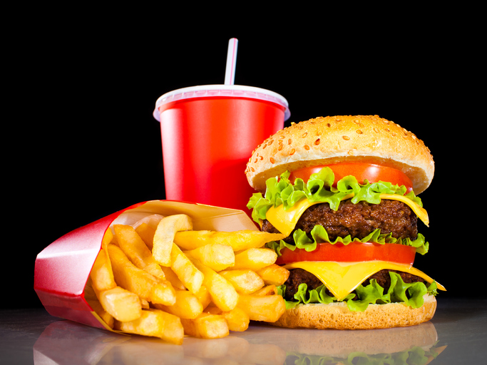

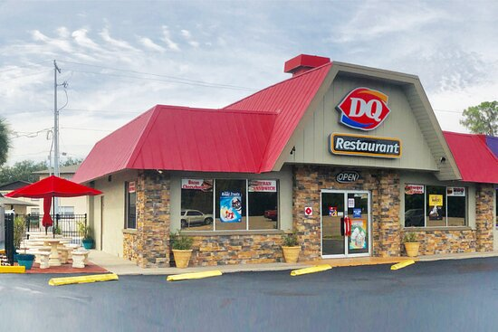


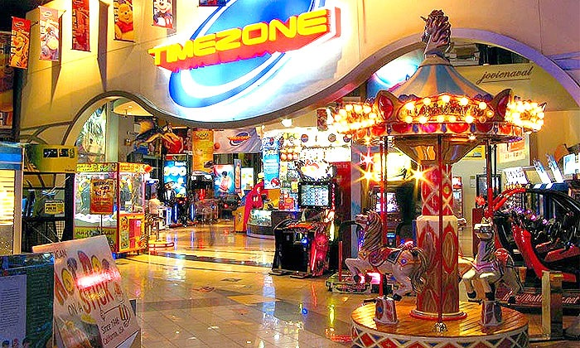
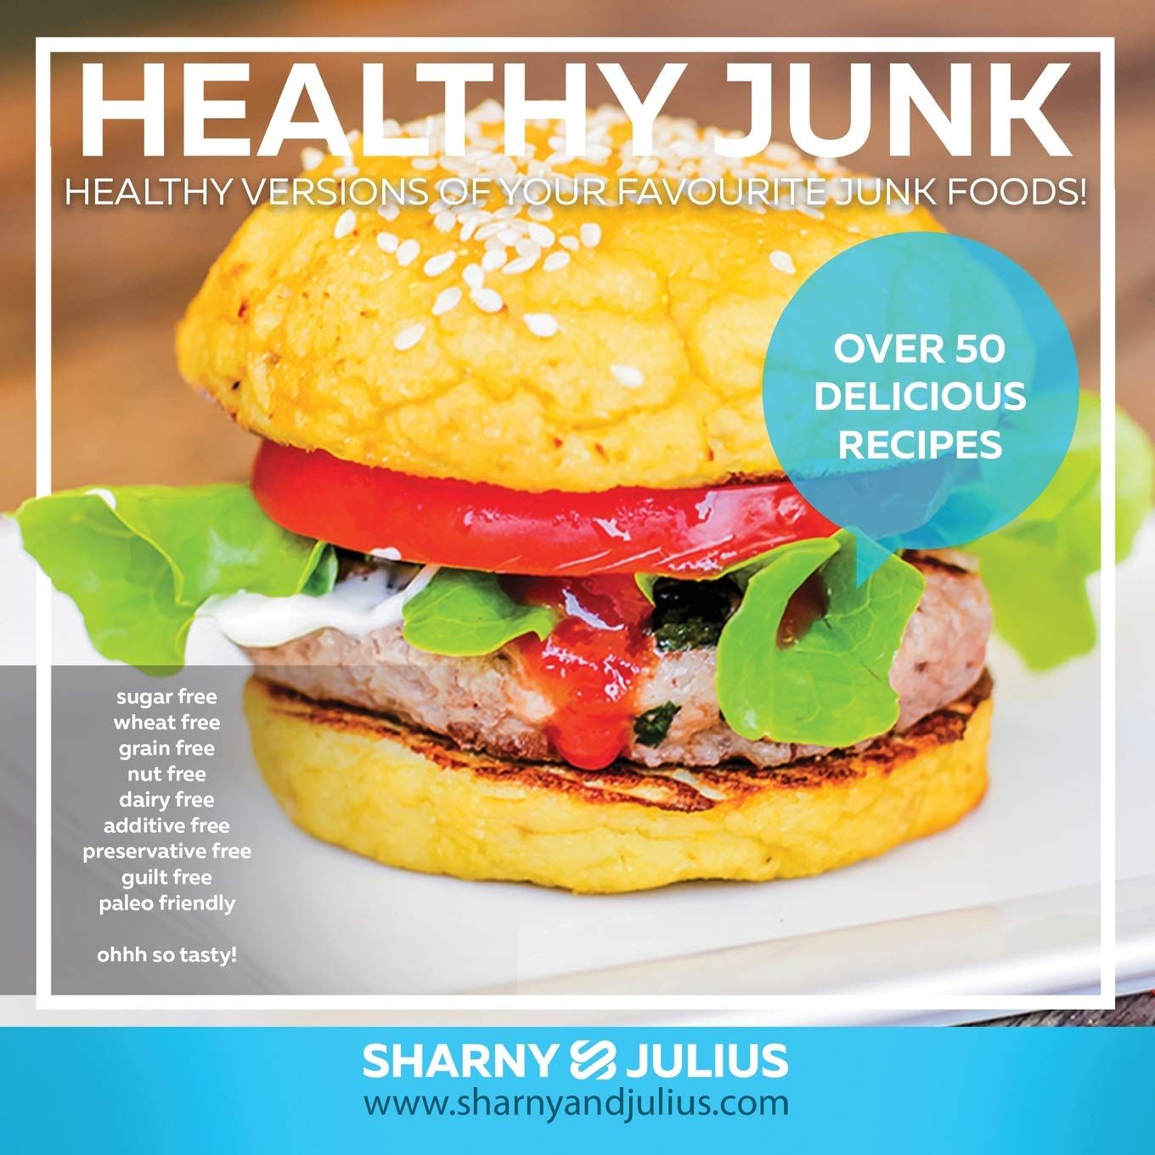
About the Brand
QSR Market in India
SWOT and TWOS matrix
Marketing Strategy
Strategic steps
Shanaya, 19, South Delhi, SRCC, Foodie, Knows Dairy Queen.
Has a sweet tooth, eats fast food at least twice a week, average spending per meal is Rs 500-700. Visits Starbucks, Taco Bell, Local cafes
Customization
Loyalty Program
Premium Ambience
Mohit, 23, Manipal, TAPMI, Foodie, Doesn’t know DQ
Student resident in Manipal, loves to explore new eateries, ice-cream and hot dog lover, Average spent Rs 300-350. Prefer Burger King over McD for quality and taste
Combo Offers
Social Media Targeting
Outlets near college/hubs
Sharma Family, 2 kids, Mumbai, Andheri, Avg. income > 20 LPA
They have a car, enjoy weekends in malls or cinema, eats at food courts of mall or near movie theatres. Kids love Ice-creams and parents prefer quality
Theatre Ads
Outlets near game zones
Healthy options

Slide 7
